Slide 1
Doing good together
My „Do good week”
Matej Krišto 7.b

Slide 2
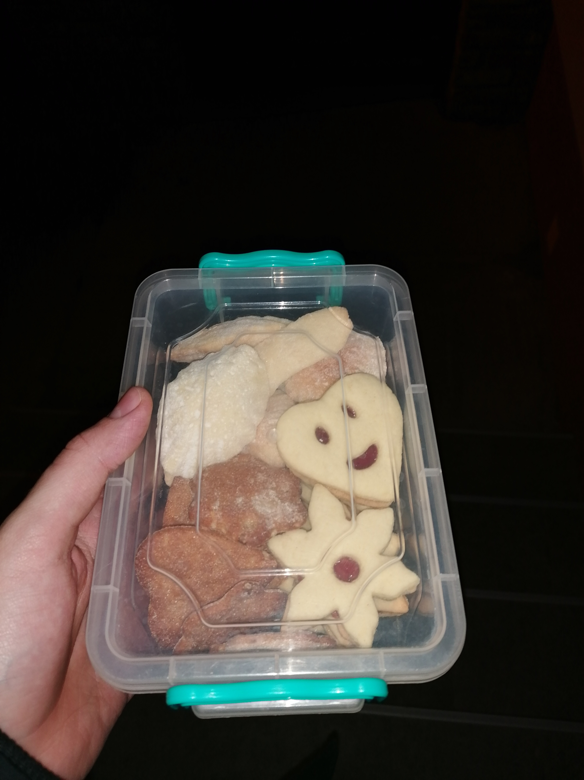
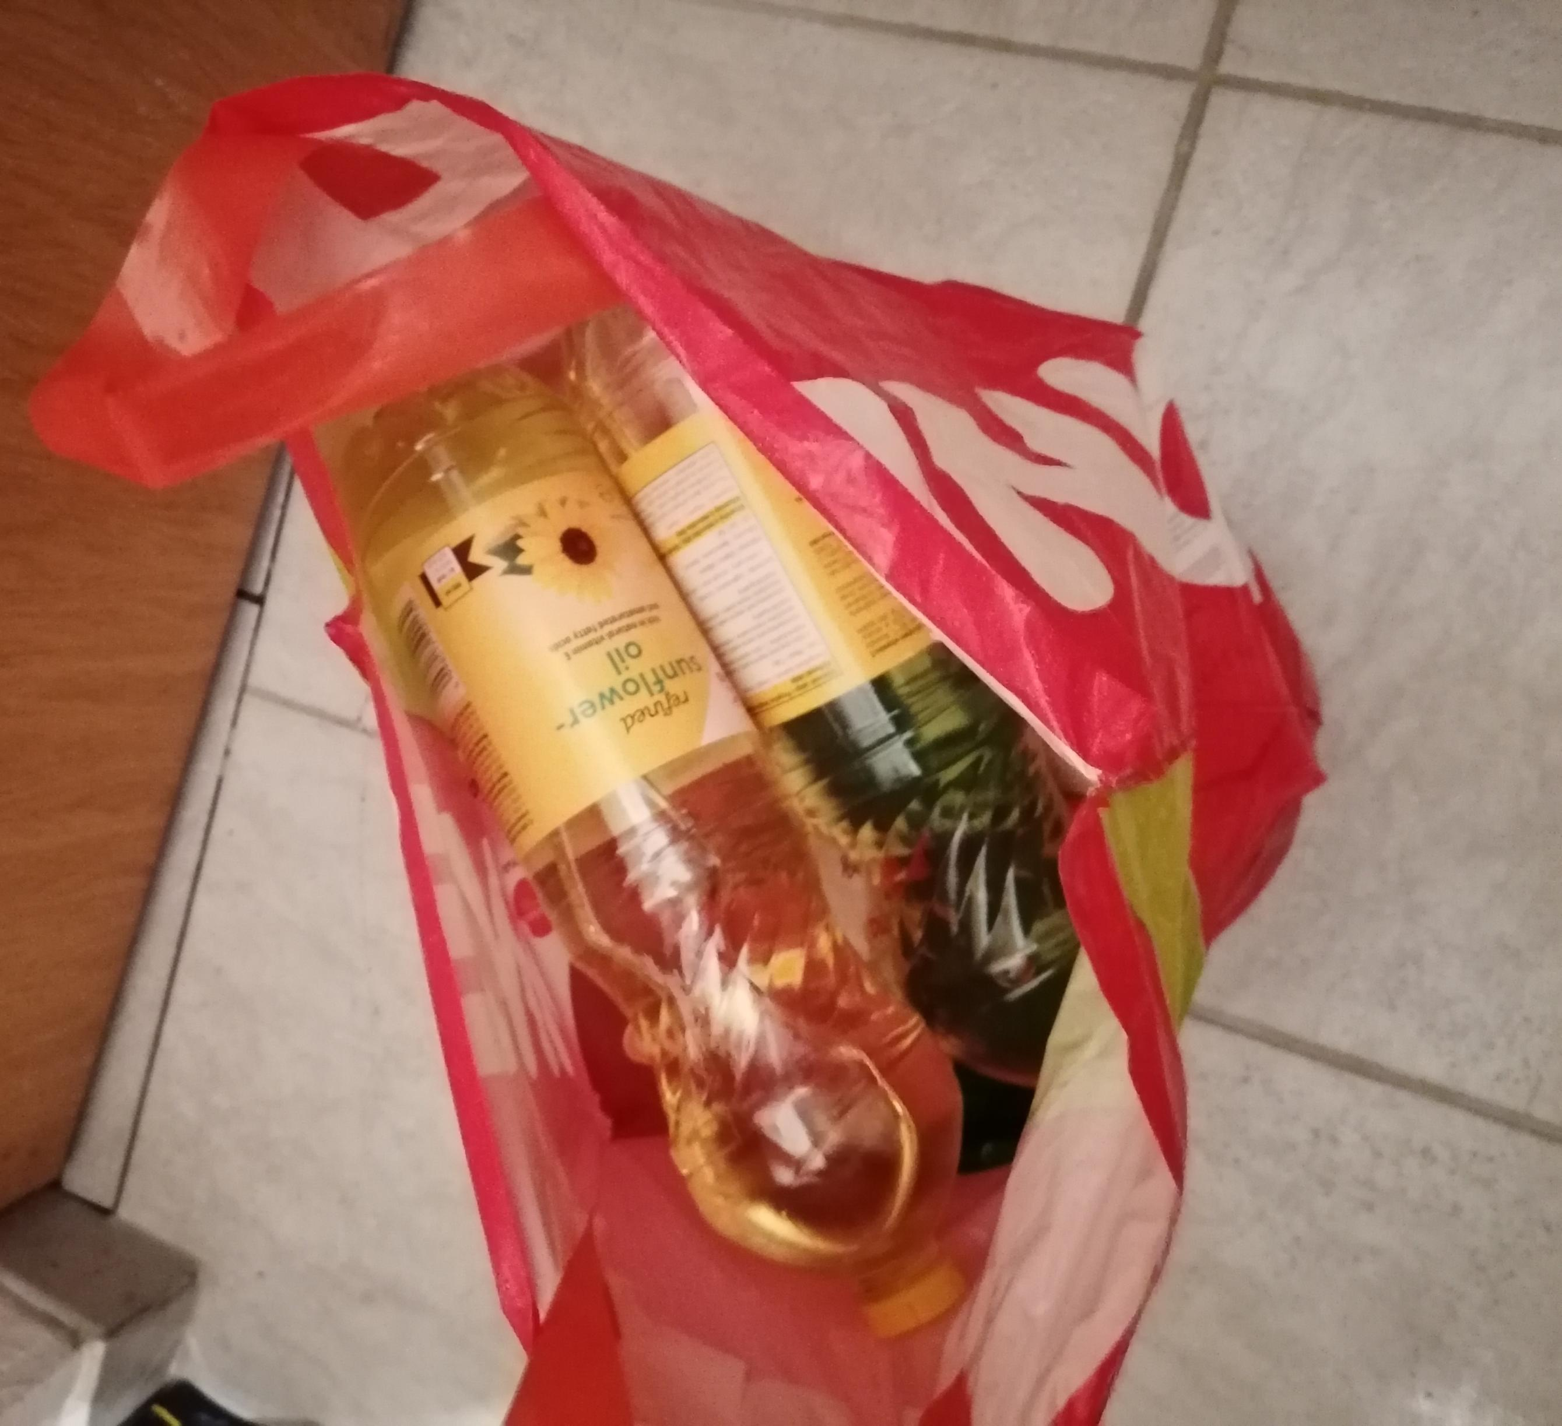
What have I done for My neighbours?
I went to the store for groceriese for my older neighbours.
I gave them homemade cookie.

Slide 3
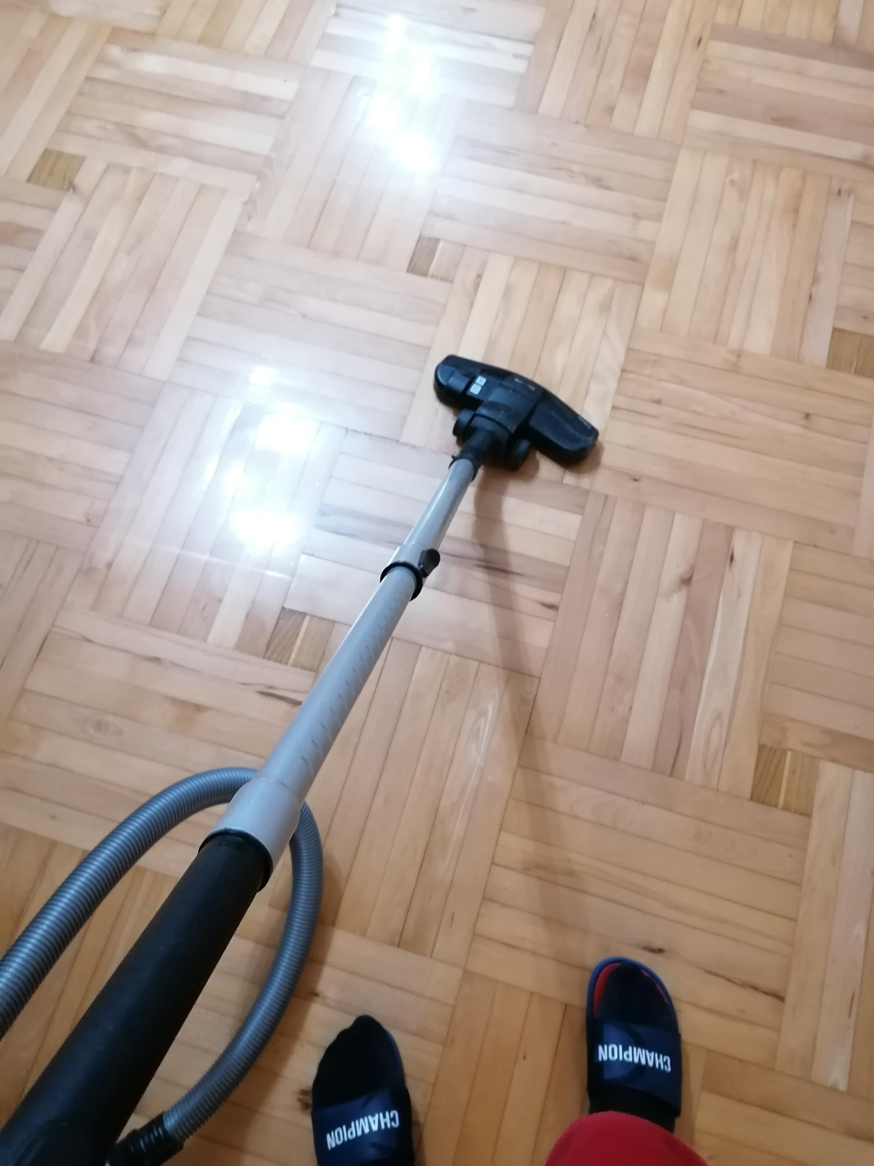
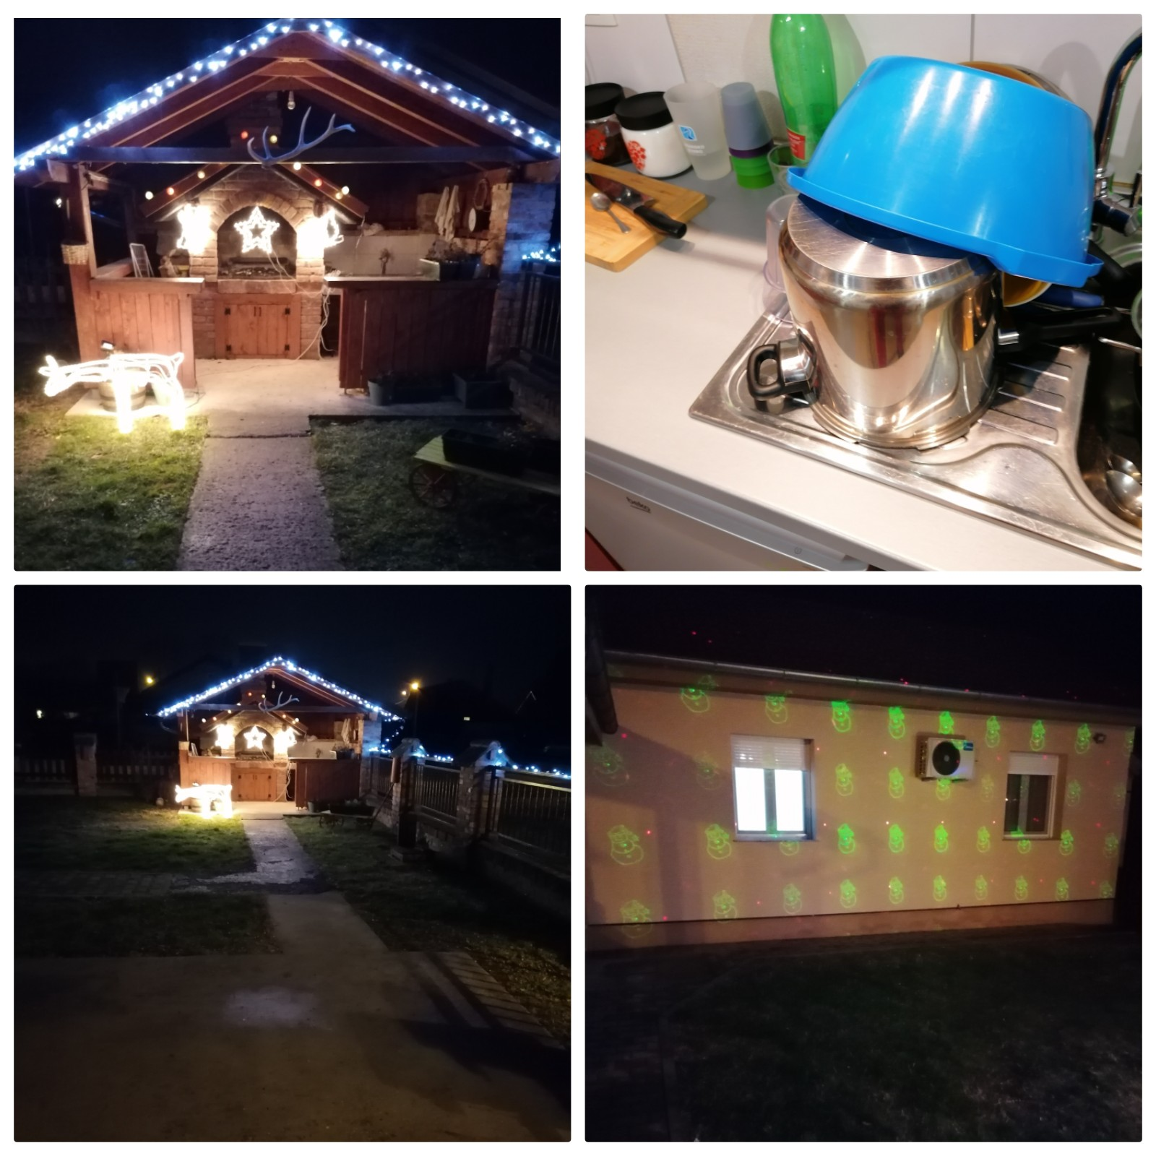
What have I Done for My parents?
I vacuumed the whole housee.
I washed the dishes.
My family and I decorated the house.

Slide 4
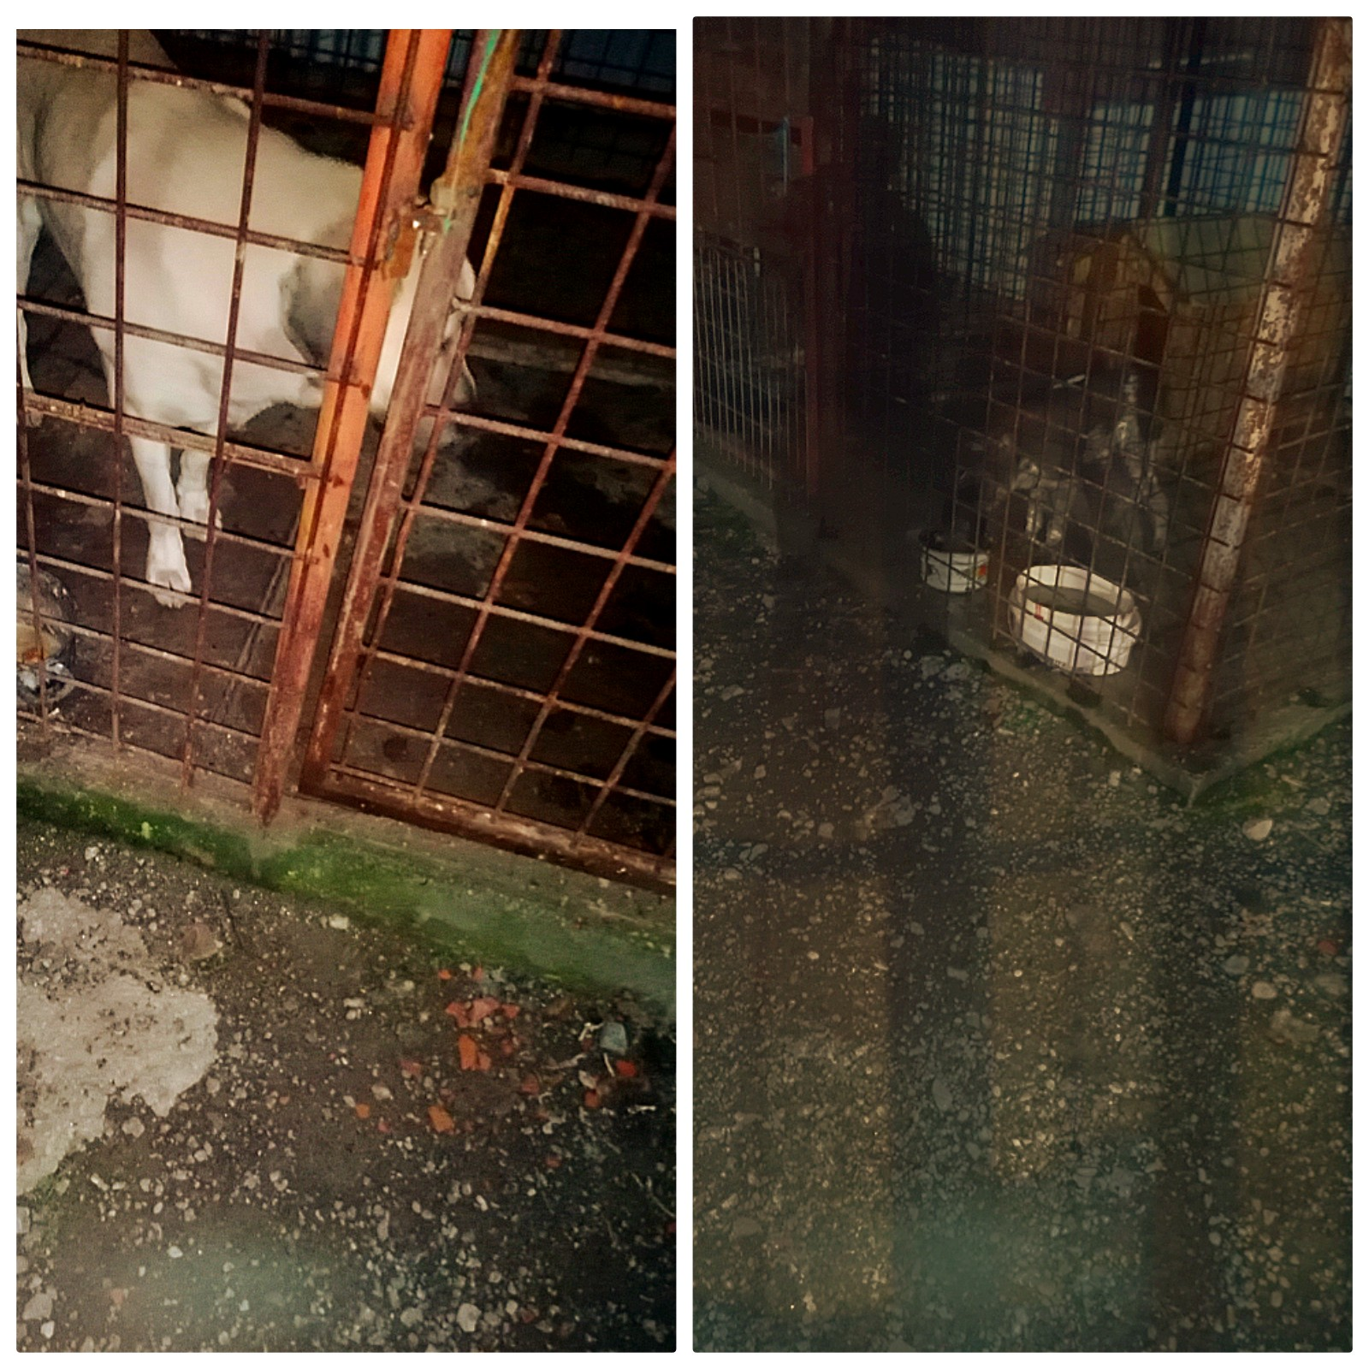
What have I done for animals?
Every day I fed my dogs.

Slide 5
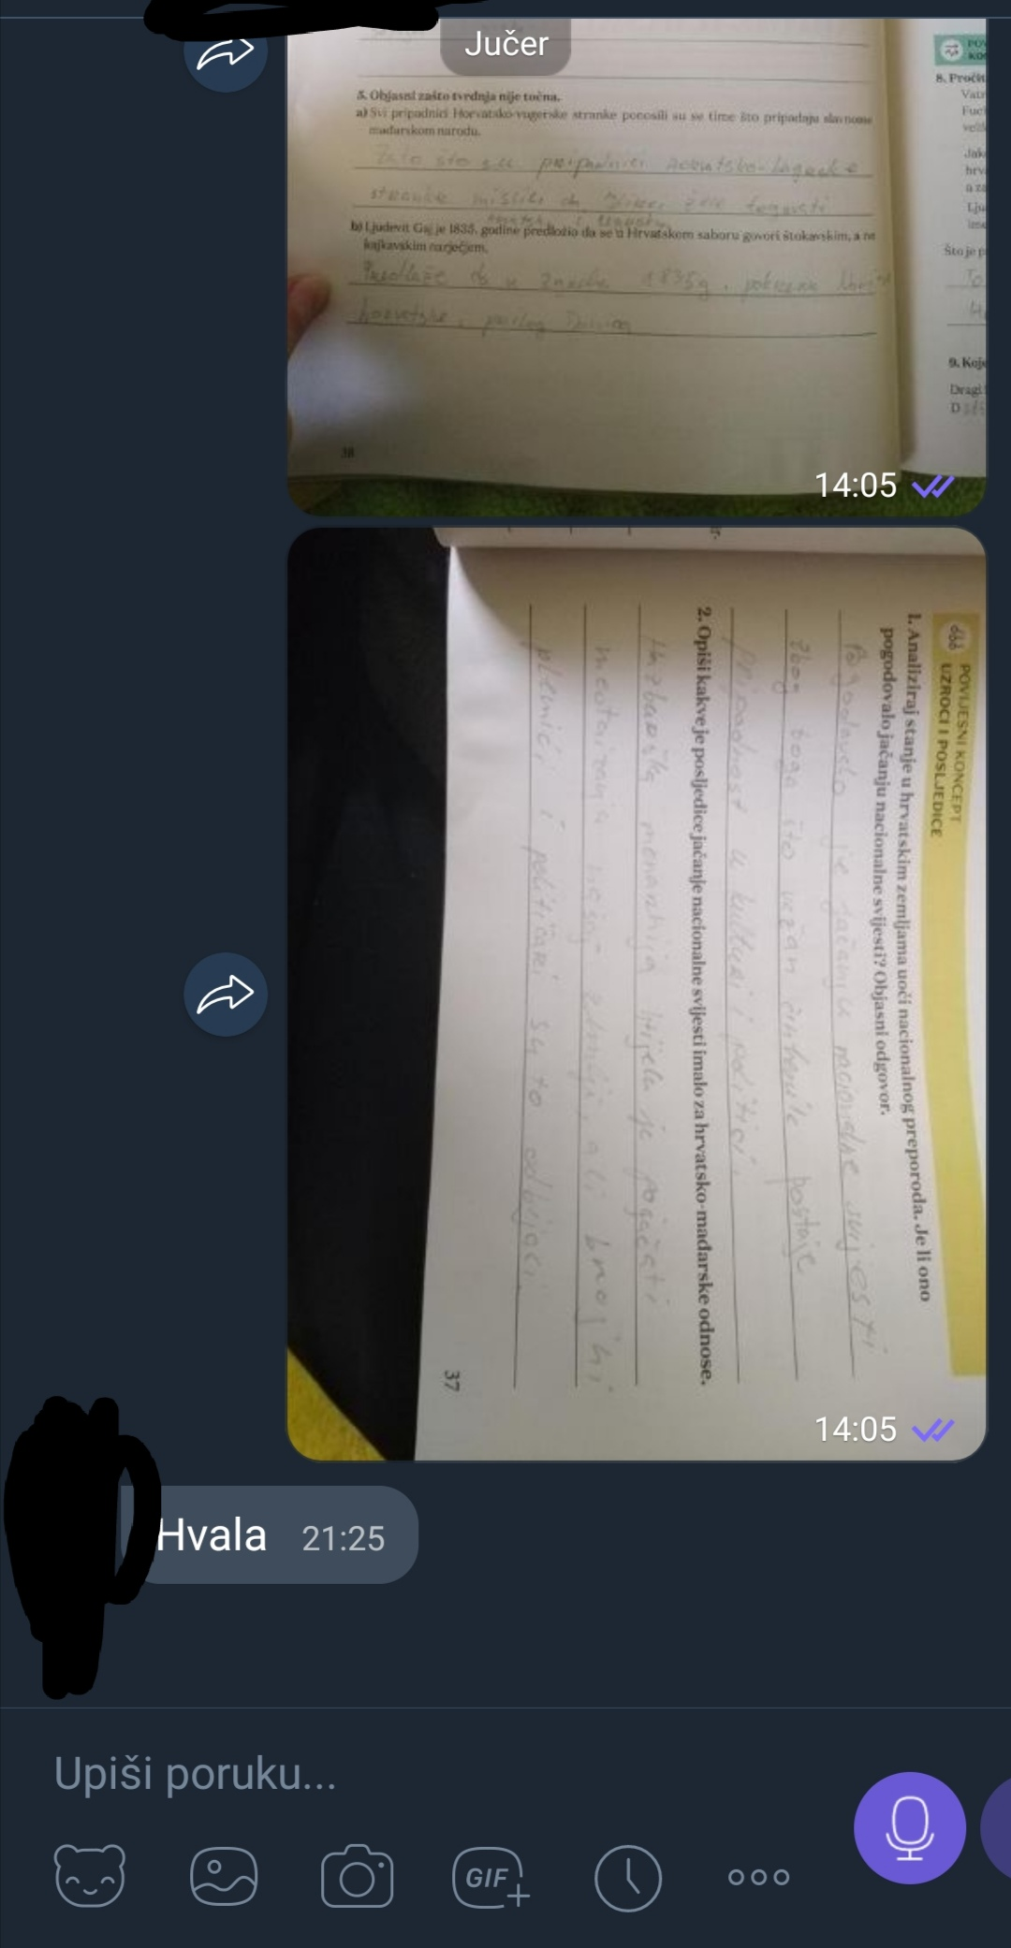
What have i done for My friend?
I lent a friend a calculator.
I helped my friend with the homework.

Slide 6
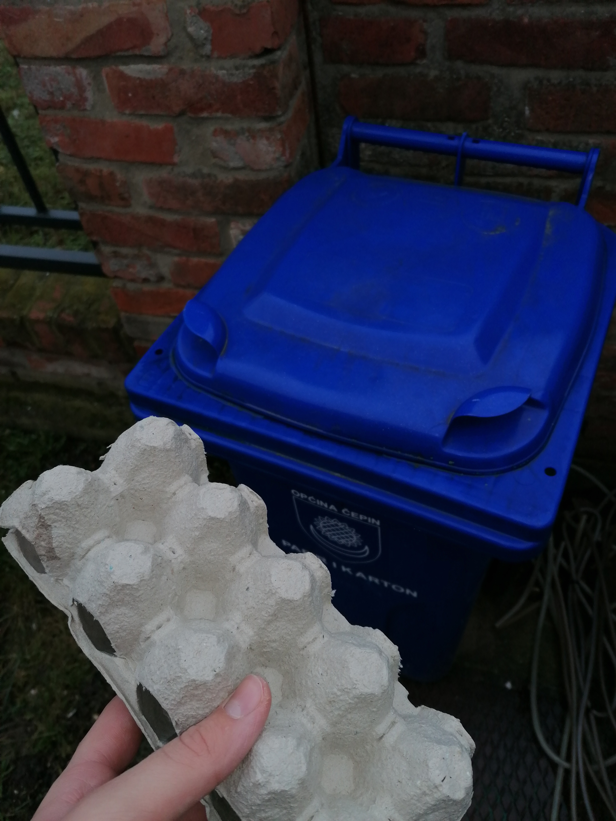
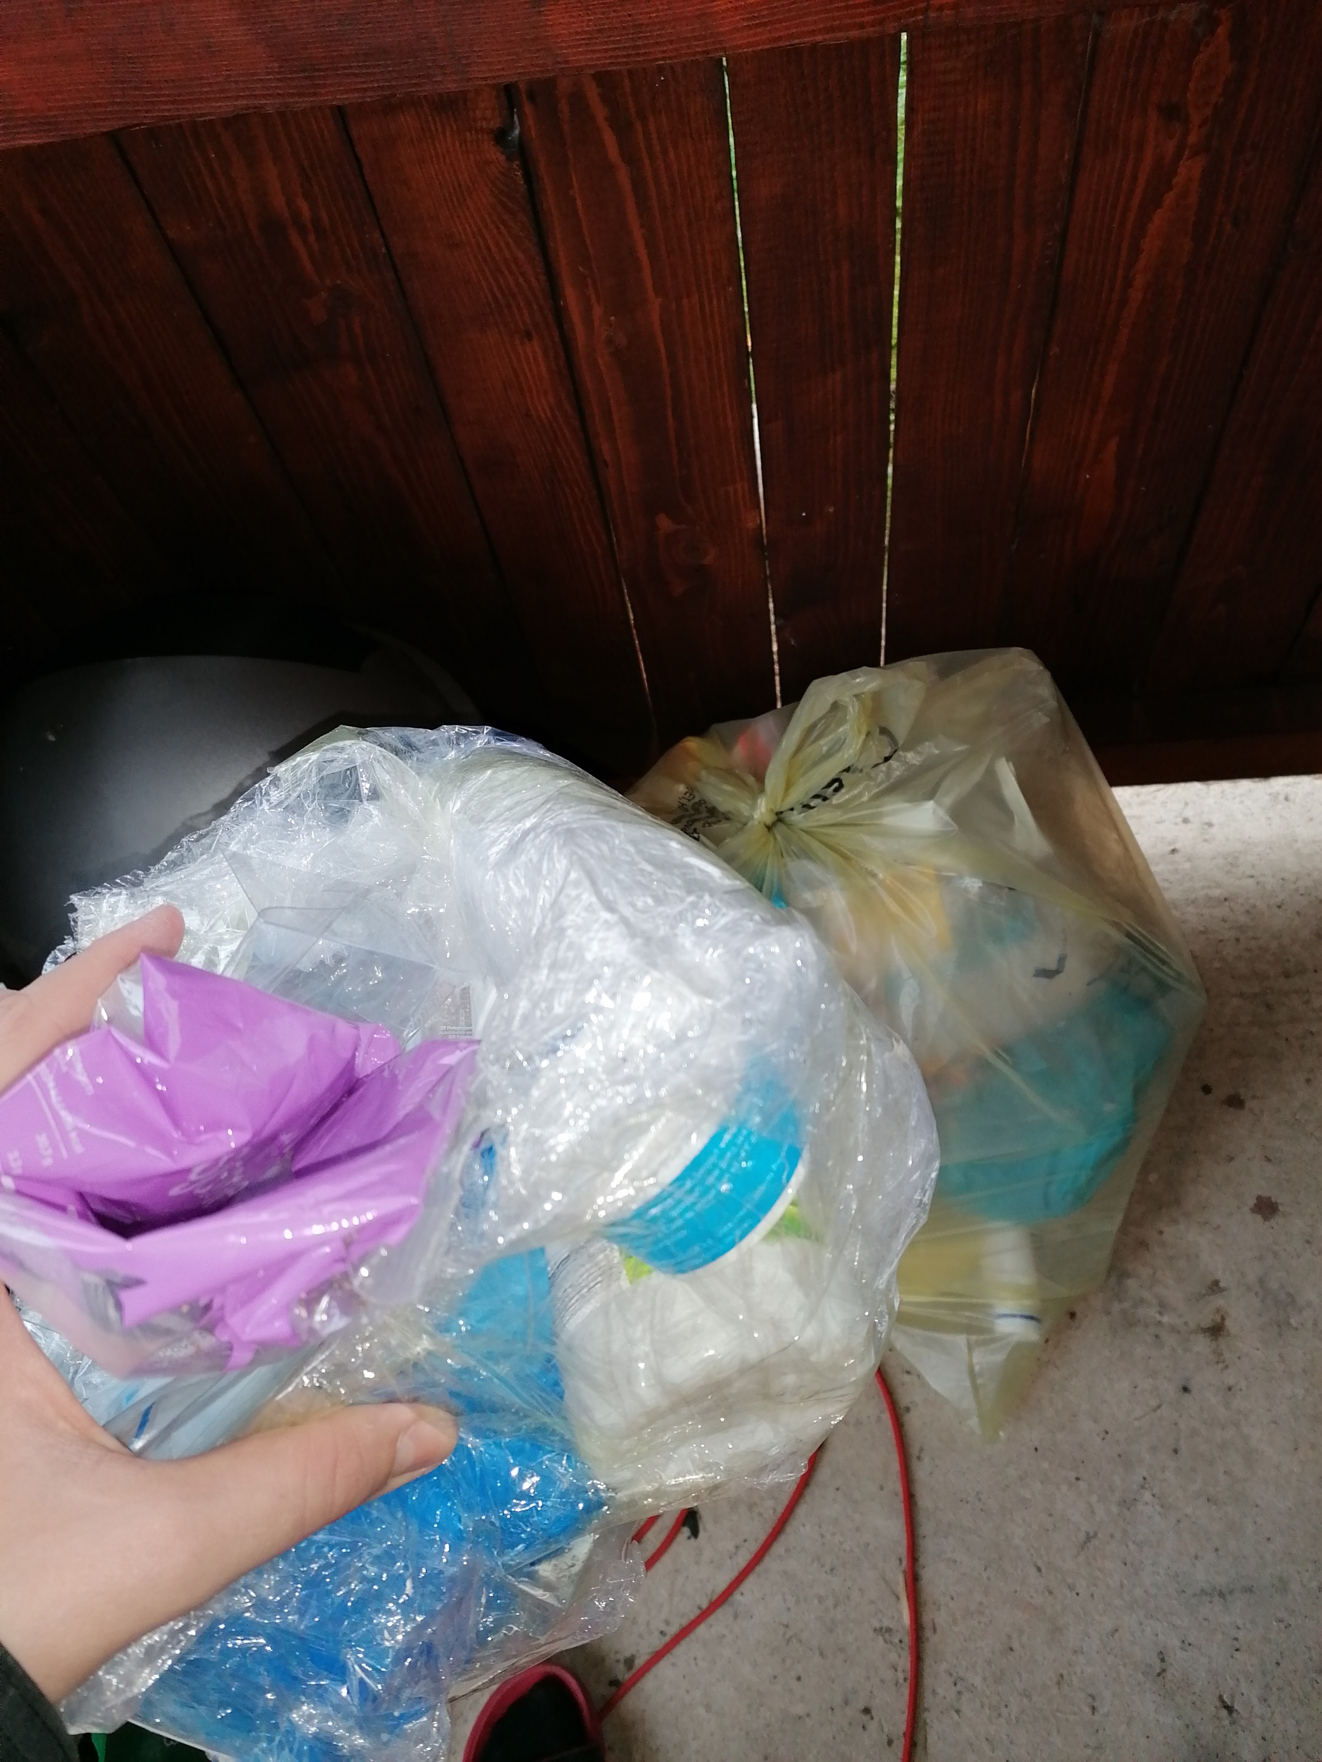
What have i done for planet?
I separeted the paper and plastic of the another trash.

Slide 7
Going in store for my neighbours and giving them cookies, fed pets.
Vacuuming the whole house, fed pets.
Lenting a friend a calculator, fed pets.
Nature conservation, fed pets.
Helping friend with homework, fed pets.
Wash the dishes, fed pets.
Decorateing house, fed pets.

Slide 8
Thank you for atention and do good deeds👍

